Slide 1
CS 355/555
Probability and Statistics for CS
Dr. Baocheng Geng
  Office: UH4147
  Email: bgeng@uab.edu
January 13, 2025
CS 355/555 Probability and Statistics for CS

Slide 2
Syllabus
Instructor: Baocheng Geng
  Office: UH4147
  Email: bgeng@uab.edu (best way to reach me)
  Office Hours: Thursdays 3-5pm
Course Webpage
  Canvas: Please log into to Canvas for up–to– date course information and announcements.
  Check your mail and the course website frequently
TAs
  Hruday Pamidi, hpamidi@uab.edu
  Sean Deng, yteng@uab.edu
  Office Hours: TBA
  Location: UH1009
Class Time and Place
CS 355/555 Probability and Statistics for CS

Slide 3






Introduction to the Class
1
Introduction
2 Class Goals
3
Formalities
4 Class format
5
History and development of probability Statistics
6 Next Time

Slide 4
Copyright Statement
Copyright Statement
Materials prepared for and/or included in this course are protected by copyright law. They are intended to be used only by students enrolled in this course during the current term and should not be further disseminated without prior permission from the course instructor.
CS 355/555 Probability and Statistics for CS

Slide 5
Probability is common sense reduced to calculation - Laplace
Introduction
CS 355/555 Probability and Statistics for CS

Slide 6
Sports Statistics
https://www.vegasinsider.com/nba/odds/futures/
CS 355/555 Probability and Statistics for CS

Slide 7
Car Insurance rates
Finance
Driving record
Age and experience
Location
Vehicle Type
Usage
Credit Score
Safety Features
Claim History
….
CS 355/555 Probability and Statistics for CS

Slide 8
Age of AI
Probability is the constructing block and fundamental element in the age of AI

Slide 9

Age of AI

Slide 10
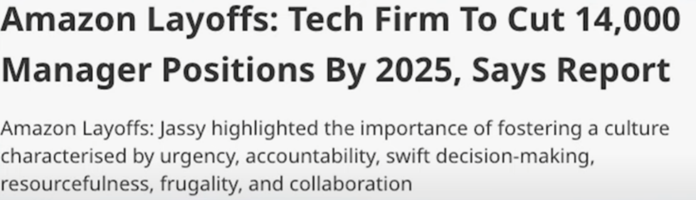
Age of AI

Slide 11

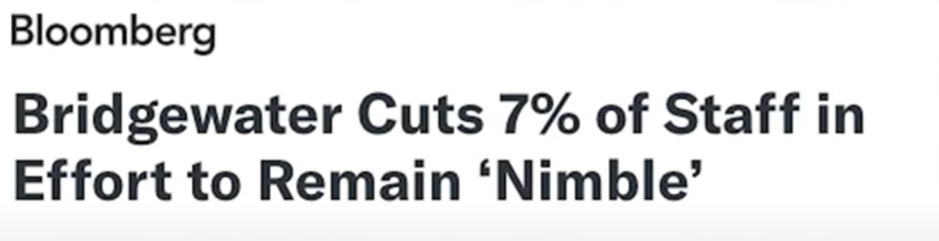
Age of AI

Slide 12
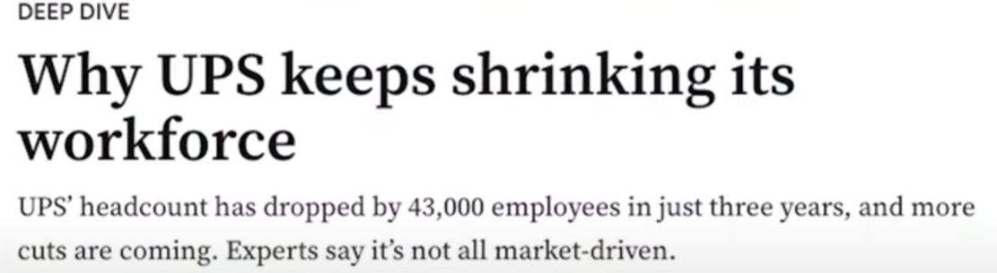
Age of AI

Slide 13

The Secretary Problem
I an administrator and wants to hire the best secretary out of n rankable applicants for a position.
The applicants are interviewed one by one in random order.
A decision about each particular applicant is to be made immediately after the interview.
Once rejected, an applicant cannot be recalled.
CS 355/555 Probability and Statistics for CS

Slide 14
The Secretary Problem
What is the optimal strategy to select the best candidate?
CS 355/555 Probability and Statistics for CS

Slide 15
The Secretary Problem
What is the best strategy to select the best candidate?
  rejecting the first 36.8% applicants that are interviewed
CS 355/555 Probability and Statistics for CS

Slide 16
The Secretary Problem
What is the best strategy to select the best candidate?
  rejecting the first 36.8% applicants that are interviewed
  Stop at the first applicant who is better than every applicant interviewed so far (or continuing to the last applicant if this never occurs)
CS 355/555 Probability and Statistics for CS

Slide 17
The Secretary Problem
What is the best strategy to select the best candidate?
  rejecting the first 36.8% applicants that are interviewed
  Stop at the first applicant who is better than every applicant interviewed so far (or continuing to the last applicant if this never occurs)
  1/e
CS 355/555 Probability and Statistics for CS

Slide 18
Class Goals
Probability goal
Make intelligent decisions both in life and work
Statistics goal
Understand large amounts of data - surveys, databases
Programming goal
Write programs that predict probabilistic events
CS 355/555 Probability and Statistics for CS
8/28 11:28

Slide 19
Early beliefs about probability
Essentially everything is determined by something outside Nature.
CS 355/555 Probability and Statistics for CS

Slide 20
Graunt Bills of Mortality
The London Life Table
Age | Survivors
0 | 100
6 | 64
16 | 40
26 | 25
36 | 16
46 | 10
56 | 6
66 | 3
76 | 1
CS 355/555 Probability and Statistics for CS

Slide 21
Graunt Bills of Mortality
Graunt found:
There were more male births than female births. Women lived longer than men.
By marriagable age, there were about as many women as men. Disease was fairly constant.
CS 355/555 Probability and Statistics for CS

Slide 22
Graunt Bills of Mortality
There were other claims related to infants, elderly.
36 out of 100 die by age 6.
60 out of 100 die by age 16.
75 out of 100 die by age 26. Hardly anybody reaches 70.
Outside of plague years, mortality statistics were very close to constant.
CS 355/555 Probability and Statistics for CS

Slide 23
Applications
Science
Engineering
Sports and Entertainment
.
.
.
.
Every domain !
CS 355/555 Probability and Statistics for CS

Slide 24
Class format, grading standards, etc.
Class Time and Place
MWF: 1:25-2:15pm
HHB 106
CS 355/555 Probability and Statistics for CS

Slide 25
Prerequisites
Fundamental course for anyone intending to become a computer scientist
  CS103 Introduction to Computer Science in Python
  CS250 Discrete Structures
  Minimum grade of C
Class Time and Place
CS 355/555 Probability and Statistics for CS

Slide 26
What to Expect
The course would be quite involved and technical
  Lots of mathematics
  Busy schedule
The grading will reflect your performance
I might make mistakes
  Please point them out
  Talk to me if you have any complaints (or send me an anonymous email)
But, I guarantee that
  You will have fun
  I’ll help you learn as fast as I can –don’t hesitate to ask for help
Class Time and Place
CS 355/555 Probability and Statistics for CS

Slide 27
What I Expect You
Please do attend lectures
Take notes and review lecture slides after each lecture
Solve textbook exercises as you read through the chapters
Ask questions and attend office hours
Try to start early on homework assignments
Follow the instructions and submit assignments on time
Class Time and Place
CS 355/555 Probability and Statistics for CS

Slide 28
Textbook
Introduction to Probability, Second Edition, Dimitri P. Bertsekas and John N. Tsitsiklis
Class Time and Place
CS 355/555 Probability and Statistics for CS

Slide 29
Class format, grading standards, etc.
Grades:
UG
 | Number | Points Each | Total
Homework | 8 | 25 | 200
Programs | 2 | 100 | 200
Tests | 2 | 150 | 300
Final Exam | 1 | 300 | 300
Total Points |  |  | 1000
Number of Points | Letter Grade
900-1000 | A
800-899 | B
700-799 | C
600-699 | D
Below 600 | F
CS 355/555 Probability and Statistics for CS

Slide 30
Class format, grading standards, etc.
Grades:
G
 | Number | Points/Percentage | Total
Homework | 8 | 25 | 200
Programs | 3 | 100 | 300
Tests | 2 | 100 | 200
Final Exam | 1 | 300 | 300
Total Points |  |  | 1000
Number of Points | Letter Grade
900-1000 | A
800-899 | B
700-799 | C
Below 700 | F
CS 355/555 Probability and Statistics for CS

Slide 31
Academic Integrity Code
You are not allowed to collaborate with any other student, in any form, while doing your homeworks, unless stated otherwise; perpetrators will at least fail the course or disciplinary action may be taken
No collaboration of any form is allowed on exams
Whenever you refer to online materials and other textbooks, you should cite so in your homeworks. This is a rule of thumb.
  Check:
  https://www.uab.edu/one-stop/images/documents/academic-integrity.pdf
Class Time and Place
CS 355/555 Probability and Statistics for CS

Slide 32
Late Homework Policy
Late submission penalty: 33.3% points deduction each day after the deadline.
Exception will be made ONLY under genuine circumstances
Class Time and Place
CS 355/555 Probability and Statistics for CS

Slide 33
AI Usage Policy
Homework assignments: No AI usage
Programming assignments: AI allowed, but MUST follow instructions and guidelines!! (documentation)
Class Time and Place
CS 355/555 Probability and Statistics for CS

Slide 34
Attendance Policy
Follow guidelines
Good attendance can earn up to 1.5 bonus point in final grade.
Class Time and Place
CS 355/555 Probability and Statistics for CS

Slide 35
Tentative Schedule
Sample space and probability, CH1 ~ 4 weeks
Discrete Random Variables, CH2 ~ 2 weeks
Test 1, 7th week
Continuous Random Variables, CH 3 ~ 3 weeks
Further Topics on Probability, CH4 ~ 1 week
Test 2, 10th week
Centrail Limit Theorem, Markov Chain and Statistical Inference ~ 4 weeks
Final, May 2nd
Class Time and Place
CS 355/555 Probability and Statistics for CS

Slide 36
Instructions
HW submissions
  Name your files “Lastname_Firstname_HW#”
  Include the “independent completion form”
  Submit it on Canvas
  Either type or write manually
Check the course web-site regularly
  I am posting lecture slides and homeworks there
Check your UAB email regularly
Only use your UAB email to communicate with me and the TA
  Please specify CS 355/555 to subject line so I can identify course
NO EXCUSES for not following instructions
Class Time and Place
CS 355/555 Probability and Statistics for CS

Slide 37
Class format, grading standards, etc.
Why do we have homework?
Academic honesty
CS 355/555 Probability and Statistics for CS

Slide 38
Class format, grading standards, etc.
DSS Peer notetaker
CS 355/555 Probability and Statistics for CS

Slide 39
How to Succeed
Come to class on time
CS 355/555 Probability and Statistics for CS
14/28 11:28

Slide 40
Come to class on time Take notes
How to Succeed
CS 355/555 Probability and Statistics for CS
14/28 11:28

Slide 41
Come to class on time Take notes
Ask questions
How to Succeed
CS 355/555 Probability and Statistics for CS
14/28 11:28

Slide 42
How to Succeed
Come to class on time Take notes
Ask questions
Do homework on time.
CS 355/555 Probability and Statistics for CS
14/28 11:28

Slide 43
How to Succeed - Homework
HW due next Sunday at 11:59pm.
When should I work on the homework?
CS 355/555 Probability and Statistics for CS
17/28 11:28

Slide 44
Tests
If you will have tests proctored by DSS, Go to the calendar on Canvas
Find tentative dates for Test 1, Test 2, Final
Call DSS and schedule proctoring for your test.
CS 355/555 Probability and Statistics for CS
18/28 11:28

Slide 45
Advice
If you sign up first you get the time you want.
If you sign up last you get the time nobody wants.
CS 355/555 Probability and Statistics for CS

Slide 46
Introduction
In the long run the odds win out.
CS 355/555 Probability and Statistics for CS

Slide 47
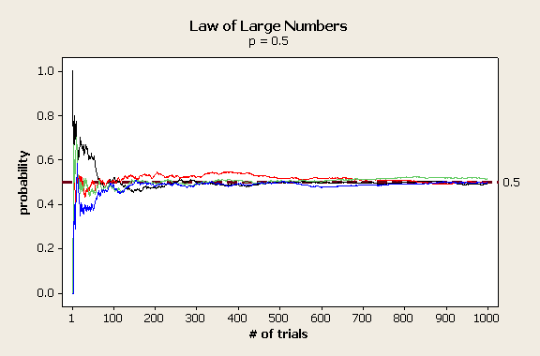
Introduction
In the long run the odds win out.
CS 355/555 Probability and Statistics for CS

Slide 48
Next Class
Read Chapter 1, 1.1
CS 355/555 Probability and Statistics for CS

